Slide 1

Consumer rights and guarantees
Year 8

Slide 2

The Australian Consumer Law (ACL)
Businesses must meet a set of basic rights called consumer guarantees when they sell products or services.

Slide 3


Slide 4
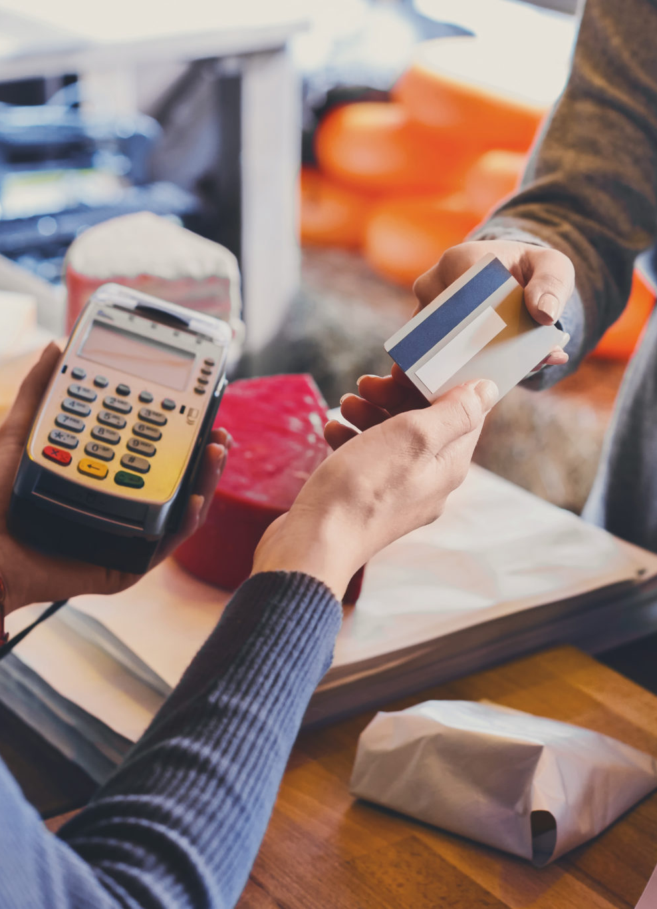
Consumer rights and guarantees
Businesses must meet a set of basic rights when they sell products or services.
These basic rights are called consumer guarantees. They are included in the Australian Consumer Law.
Consumers automatically receive these consumer guarantees when they buy goods and services.
It is unlawful for businesses to mislead consumers about these rights.

Slide 5


Slide 6
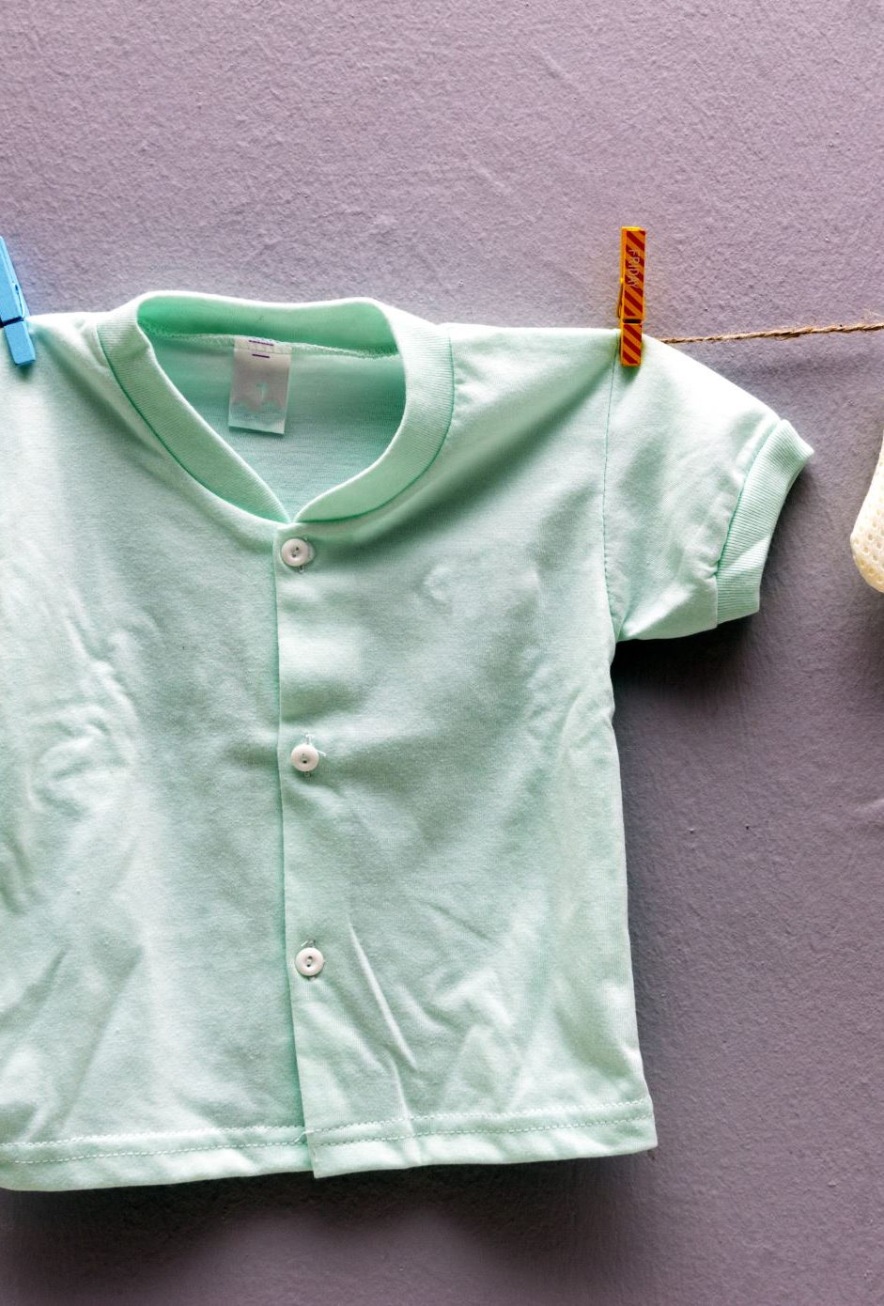
From the video
Decide which statement is true or false.
1. Lawrence is happy with his purchase.
2. Lawrence wants a refund but has lost his receipt.
3. Charlotte demands a proof of purchase from Lawrence.
4. Lawrence is annoyed that the shirt he bought had a rip in it.
5. Charlotte tells Lawrence to fill out a form so she can organise his refund.

